Slide 1
Discrete Mathematics and Its Applications

Slide 2

Course Staff
Instructor
杨娟
Office: 教3楼616
Phone: 62283778
Email: yangjuan@bupt.edu.cn
Assistants
陈屹贝
QQ课程群
QQ号：2156031338
密码：304306

Slide 3
Introduction
Computer Science
Discrete Mathematics
Study Material
Course Objectives
Course Arrangement

Slide 4
计算机科学与技术学科
计算机科学与技术学科是研究计算机的设计与制造，利用计算机进行信息获取、表示、存储、处理、控制等的理论、原则、方法和技术的学科。
计算机科学与技术学科包括科学与技术两个方面，是科学性与工程性并重的学科。
计算机科学侧重于研究现象，揭示规律。
计算机技术则侧重于研制计算机和研究使用计算机进行处理的方法和技术手段。
科学性：基础—逻辑能力，思辨精神
工程性：应用—分析问题，解决问题

Slide 5
计算机科学与技术学科的根本问题
根本问题是：什么能被（有效地）自动化。
“离散数学”对该学科的重要性
问题描述
问题求解
处理对象是离散的。

Slide 6
学科的三个形态
抽象—理论—设计
抽象源于现实世界建立对客观事物进行抽象描述的方法。建立具体问题的概念模型，实现对客观世界的感性认识。
理论源于数学。建立完整的理论体系，建立具体问题的数学模型，从而实现对客观世界的理性认识。
设计源于工程。对客观世界的感性认识和理性认识的基础上，完成一个具体的任务；对工程设计中所遇到的问题进行总结，提出问题，由理论界去解决它。

Slide 7
典型的学科方法
数学方法
系统科学方法

Slide 8
专业能力培养
4种基本的专业能力
计算思维能力
算法的设计与分析能力
程序设计和实现能力
计算机软硬件系统的认知、分析、设计与应用能力
计算思维能力
逻辑思维能力和抽象思维能力
构造模型对问题进行形式化描述
理解和处理形式模型

Slide 9
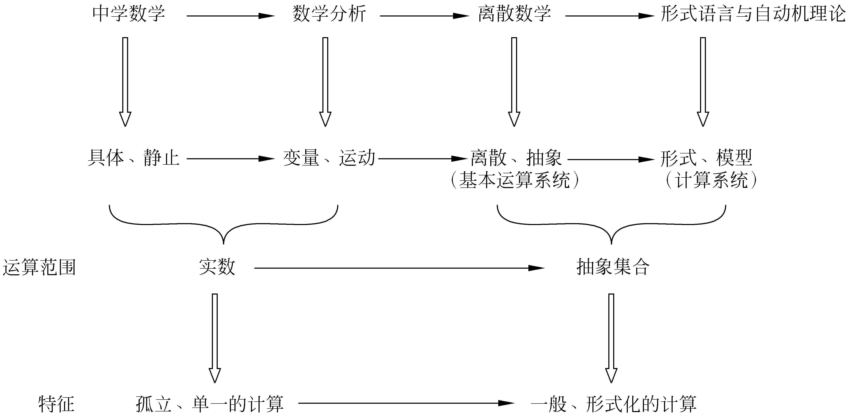
“计算思维”梯级训练系统

Slide 10
What is Discrete Mathematics?
Discrete mathematics is the part of mathematics devoted to the study of discrete (as opposed to continuous) objects.
Calculus deals with continuous objects and is not part of discrete mathematics.
Examples of discrete objects: integers, steps taken by a computer program, distinct paths to travel from point A to point B on a map along a road network, ways to pick a winning set of numbers in a lottery.
A course in discrete mathematics provides the mathematical background needed for all subsequent courses in computer science and for all subsequent courses in the many branches of discrete mathematics.

Slide 11
Why Study Discrete Math?
The basis of all of digital information processing is: Discrete manipulations of discrete structures represented in memory.
It’s the basic language and conceptual foundation for all of computer science.
Discrete math concepts are also widely used throughout math, science, engineering, economics, biology, etc., …
A generally useful tool for rational thought!

Slide 12
Uses in Computer Science
Advanced algorithms & data structures
Programming language compilers & interpreters.
Computer networks
Operating systems
Computer architecture
Database management systems
Cryptography
Error correction codes
Graphics & animation algorithms
game engines, etc.…
almost the whole fields!

Slide 13
Kinds of Problems Solved Using Discrete Mathematics
How many ways can a password be chosen following specific rules?
How many valid Internet addresses are there?
What is the probability of winning a particular lottery?
Is there a link between two computers in a network?
How can I identify spam email messages?
How can I encrypt a message so that no unintended recipient can read it?
How can we build a circuit that adds two integers?

Slide 14
Kinds of Problems Solved Using Discrete Mathematics
What is the shortest path between two cities using a transportation system?
Find the shortest tour that visits each of a group of cities only once and then ends in the starting city.
How can we represent English sentences so that a computer can reason with them?
How can we prove that there are infinitely many prime numbers?
How can a list of integers be sorted so that the integers are in increasing order?
How many steps are required to do such a sorting?
How can it be proved that a sorting algorithm always correctly sorts a list?

Slide 15
What Will We Study?
Content:
An up to date grasp of fundamental problems and solutions
Method:
Principles and techniques to solve the vast array of unfamiliar problems that arise in a rapidly changing field.

Slide 16
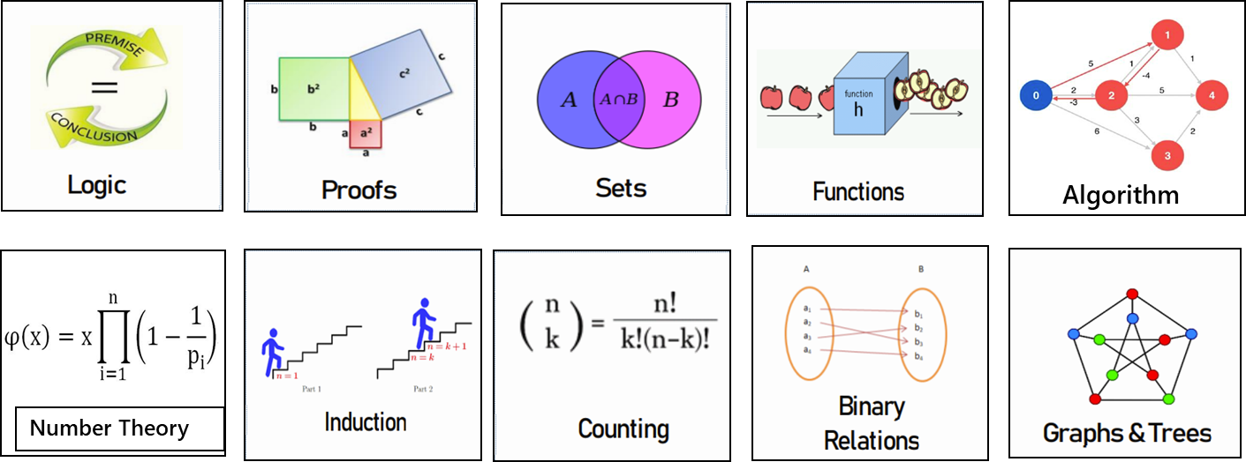
What Will We Study?
Discrete
Structures
Notes:
Here are just a few of the kinds of discrete structures and related concepts that we’ll be studying this semester.
Induction，recursion

Slide 17
Count without counting
Estimate
Calculate
Analyze

Slide 18
Induction has many guises
Master their interrelationship.
Formal Arguments
Loop Invariants
Recursion
Algorithm Design
Recurrences

Slide 19
Growth Rates
Time
Input Size

Slide 20
Recursion
?
?

Slide 21
Randomization

Slide 22
Hashing

Slide 23
Self Reference

Slide 24
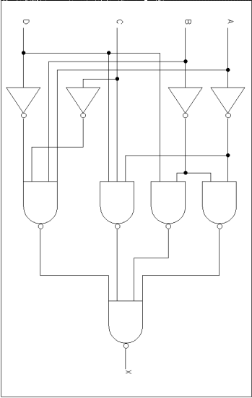
Reduction
=

Slide 25
Parallel Versus Sequential Work

Slide 26
Dating

Slide 27
Private Communication

Slide 28
Factoring / Multiplication
p, q
pq

Slide 29
Infinity

Slide 30
Map Coloring

Slide 31
What Will We Study?
Method:
Principles and techniques to solve the vast array of unfamiliar problems that arise in a rapidly changing field.

Slide 32
Exemplification
Try out a problem or solution on small examples.

Slide 33
Representation
Understand the relationship between different representations of the same information or idea
1
2
3

Slide 34
Modularity
Decompose a complex problem into simpler subproblems

Slide 35
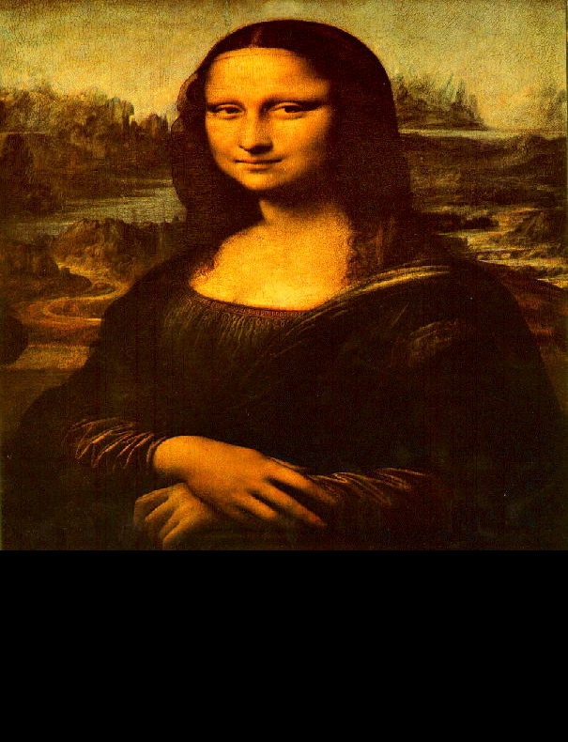
Abstraction
Abstract away the inessential features of a problem
=

Slide 36
Refinement
The best solution comes from a process of repeatedly refining and inventing alternative solutions

Slide 37
Similarity
A significant form of intellectual progress is to be able to classify and manipulate distinct objects with regard to a sense in which they are similar.
=
13 = 21 (modulo 2)

Slide 38

Toolbox
Build your toolbox of abstract structures and concepts. Name your tools. Know the capacities and limits of each tool.

Slide 39
课程目标
本课程旨在让学生了解离散数学基础知识的同时培养学生逻辑和数学的思维方式，掌握扎实的与计算技术相关的数学知识和基础理论，培养学生能够将离散数学基本理论知识应用于解决复杂工程的能力，同时通过采用英文材料和双语教学，培养学生对计算机专业相关英文资料的阅读理解能力以及英文的沟通和交流能力。

Slide 40
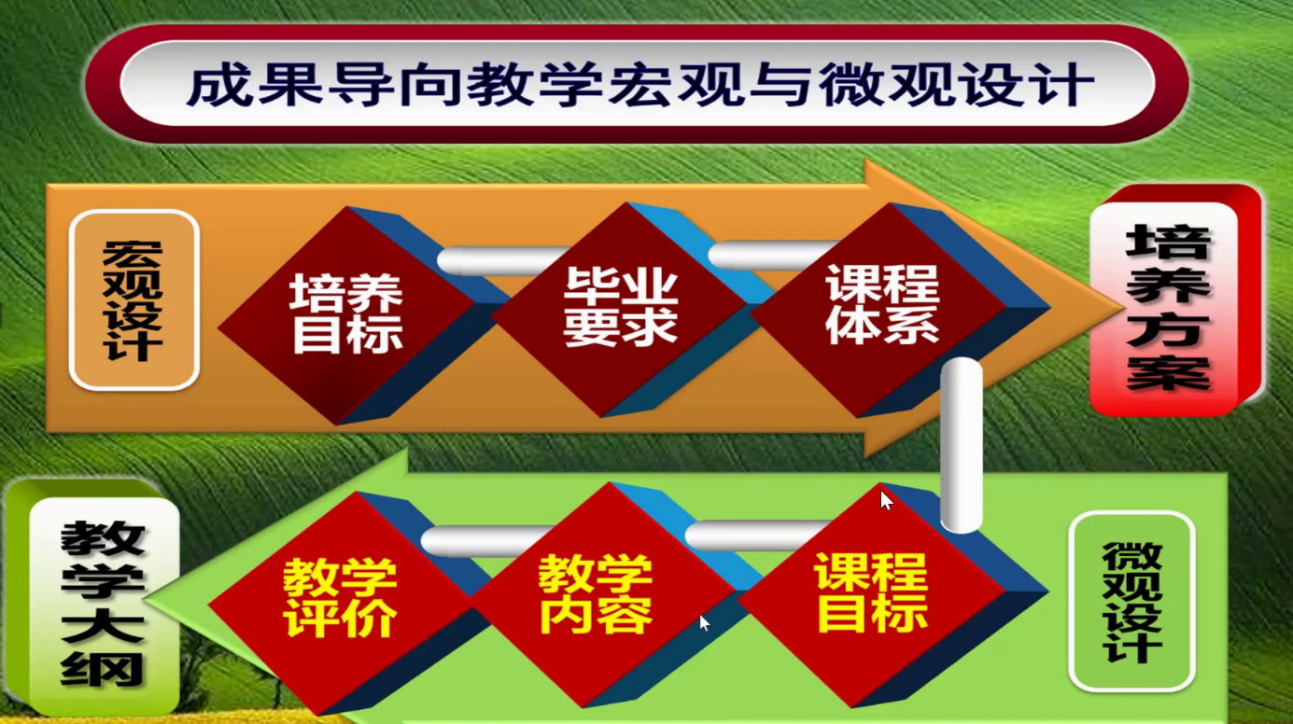
成果导向的教育理念和培养体系
反向设计：从培养目标开始
由毕业要求确定
课程目标决定教学内容

Slide 41
课程目标对毕业要求的支撑
支撑的毕业要求指标点1.1：
掌握解决复杂工程问题所需的数学、自然科学和工程基础知识，能从数学与工程角度对复杂工程问题表述、分析和建模，对模型进行严谨的推理，达到正确性或可用性要求。
课程目标1：
理解逻辑和数学推理方法，这些方法是数学证明和程序设计的重要基础；培养学生严谨的逻辑推理能力

Slide 42
课程目标对毕业要求的支撑
支撑的毕业要求指标点2.1：
针对计算机系统和领域复杂工程问题进行问题识别，分析其功能需求与非功能需求，识别其面临的各种制约条件，对任务目标给出需求描述。
课程目标2：
了解包括集合、排列、关系、图、树等典型的抽象的离散结构，这些结构是计算机程序处理的主要对象；培养学生对复杂工程问题用计算机专业语言的刻画能力。

Slide 43
课程目标对毕业要求的支撑
支撑的毕业要求指标点2.2：
根据计算机系统和网络领域复杂工程问题的需求描述，运用数学、自然科学和工程科学原理及方法进行分析，建立解决问题的抽象模型。
课程目标3：
学习基本计数技术，建立初步的组合分析思维方法；培养学生运用数学原理解决工程问题的能力
课程目标4：
认识到所学的离散数学知识在计算机等相关领域的实际应用，并能对算法、离散数学知识在解决复杂工程问题中应用和建模有深入理解；培养学生运用离散数学及方法解决工程问题的能力

Slide 44
课程目标对毕业要求的支撑
支撑的毕业要求指标点10.2：
熟练掌握一门外语，了解计算机系统和网络领域国际发展趋势和研究热点，具备一定的国际视野，能够在跨文化背景下进行沟通、交流与合作。
课程目标5：
熟悉计算机相关数学知识的英文表述方法，培养计算机专业相关英文材料的阅读理解能力和初步交流沟通能力

Slide 45
Course Arrangement
Chap 1-The foundations:Logic and Proofs.
Chap 2-Basic Structures
Chap 3-Algorithm
Chap 4-Number Theory
Chap 5-Induction and Recursion
Chap 6-Counting

Slide 46
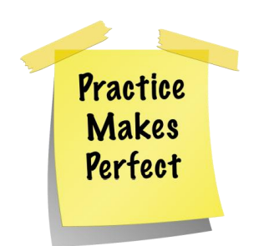
How to study
上课认真听讲，下课按时做作业
学习过程比内容更重要
英文教材：学习知识并非学习英语
常见问题：我上课都能听懂，但为什么不会解决实际问题呢？
练习，练习，再练习

Slide 47
Grading Scheme
Homework assignments (30%)
Midterm examination (20%)
Final examination (50%)

Slide 48
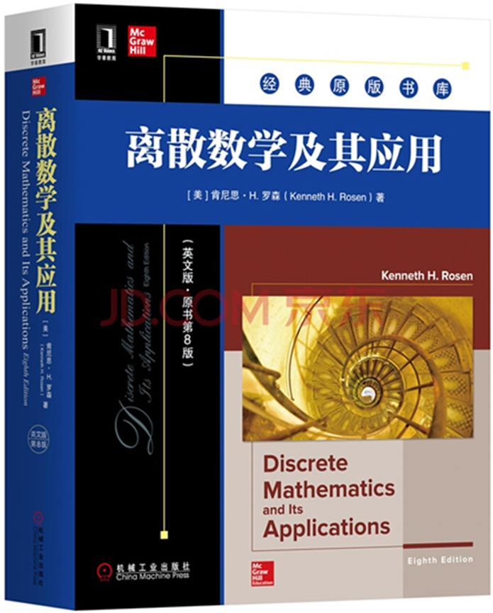
Textbook & References
Discrete Mathematics and Its Applications/8e, Kenneth H. Rosen, 2020
离散数学结构(第6版) 科曼(BernardKolman) 高等教育出版社:2010
离散数学及应用（第3版），刘铎编著，清华大学出版社：2022
离散数学及应用学习指导与习题解析，刘铎编著，清华大学出版社：2022
离散数学基础，周晓聪等编著，清华大学出版社：2022

Slide 49
Q & A
Please feel free
to ask questions!
((( )))
Suggestions and Comments
To:yangjuan@bupt.edu.cn

